Slide 1
Making this resource work for you
Prior to teaching this lesson, please refer to the ‘Unit Overview and Planning Document’.
Further guidance on planning Science Mastery lessons can be found in the detailed planning guidance document.
Refer to the ‘notes’ section on each slide for useful information, including suggested expositions, pedagogical content knowledge, suggested questions, answers and more. Consider using presenter mode so you can see this guidance throughout the lesson.
The introduction slides can be adapted to suit your teaching style and the needs of your class.
Before the lesson, adapt the fix-it slide to address any misconceptions identified in the previous lesson’s exit ticket.
Choose from the suggested activities to suit your class. The intention is not that you complete all of these, but that you select those which ones are most appropriate for your students. It may be appropriate to further adapt activities for your students.
These lessons are designed to occupy approximately 1 hour. To adapt for a shorter or longer lesson duration we advise you to adapt the activity section accordingly.
Please consider using the final slide to send feedback about this lesson or examples of PowerPoints that you have adapted to our design team. Your feedback is used to improve Science Mastery for all of our teachers and students. We appreciate all suggestions and comments.
Thank you for reading!
The Science Mastery Team

Slide 2

Taking it Further: Alkenes
Answer the questions below.
State the two products of cracking.
Describe the difference between ethane and ethene.
Describe how to test for an alkene.
State the general formula for the alkanes.
State how many pairs of electrons are shared in a double covalent bond.
An alkane and an alkene.
Ethane is an alkane so contains all single bonds while ethene is an alkene so contains a C=C double bond.
Add bromine water, alkenes turn bromine water colourless.
C_{n}H_{2n+2}
2
Notes:
Big idea: Reactions rearrange matter
Foundation: State the chemical formula for ethene.
Stretch: Explain why it is useful to crack hydrocarbons.
Answers:
Foundation: C₂H₄
Stretch: As it produces shorter chain hydrocarbons, which there is greater demand for as they are used in fuels.

Slide 3
Taking it Further: Alkenes
Do Now:
State the two products of cracking.
Describe the difference between ethane and ethene.
Describe how to test for an alkene.
State the general formula for the alkanes.
State how many pairs of electrons are shared in a double covalent bond.
Drill:
Draw the structural formula for ethane.
Draw the structural formula for ethene.
Name the type of compound that alkanes and alkenes are.
Notes:
Drill answers:
Drawn out C2H6
Drawn out C2H4
Hydrocarbons

Slide 4
Taking it Further: Alkenes
Read Now:
The alkenes are a homologous series of hydrocarbon compounds. Their functional group is a double bond between carbon atoms, which gives them their reactivity. Because of this double bond, alkenes are described as unsaturated. This also means that they are very useful in many chemical reactions in the petrochemical industry, used to make many different polymers and plastics. The smallest of the alkenes is ethene, as there is no such thing as methene, because there could not be a carbon=carbon double bond when there is only one carbon atom present. Alkenes can be very large and branched molecules, and the properties of each molecule determine what the molecule may be useful for.
Identify the functional group of the alkenes.
Explain why the alkenes are described as unsaturated.
Identify the smallest alkene.
Explain why there is no such thing as methene.
Describe what alkenes are used for.

Slide 5

C5.1.6
15/08/2024
Taking it Further: Alkenes
C5.1.1 Prior Knowledge Review
C5.1.2 Crude Oil and Hydrocarbons
C5.1.3 Fractional Distillation
C5.1.4 Combustion of Hydrocarbons
C5.1.5 Cracking
C5.1.6 Taking it Further: Alkenes
C5.1.7 Taking it Further: Alcohols
C5.1.8 Taking it Further: Producing Ethanol by Fermentation
C5.1.9 Taking it Further: Producing Ethanol from Ethene
C5.1.10 Taking it Further: Carboxylic Acids
C5.1.11 Taking it Further: Esters
C5.1.12 Polymers
C5.1.13 Taking it Further: Addition Polymerisation
C5.1.14 Taking it Further: Condensation Polymerisation
C5.1.15 Taking it Further: Naturally Occurring Polymers
Notes:
Big Idea: Structure Determines Properties
This is the first lesson of the chemistry only content. In it students will build on their knowledge of alkenes from cracking and look at their structures and reactions. The reaction between alkenes and water to form alcohols is covered in the formation of ethanol from ethene lesson.
Suggested Hook:
What is the difference between an alkane and an alkene?
What could you use to tell the difference between them?

Slide 6

Following this lesson, students will be able to:
State the general formula of the alkenes
Use chemical formulae to determine numbers of atoms in molecules
Describe chemical reactions of the alkenes
Key Words:
alkene
double bond
unsaturated
functional group
homologous series
Notes:
Guidance:
See unit overview document and planning guidance to see how these objectives are typically assessed at GCSE, including examples of what students should be able to do following this lesson.
Planning for different needs:
The learning objectives given on this slide are suggested based on the most common requirements for exams, however they can be adapted based on the needs of different classes.
For best practice, the unit preparation booklet should be used to determine the appropriate focus of lessons within the unit.
While it is not possible to explicitly split content into levelled grades, we recommend that lesson objectives can be classified as critical, core or stretch.
Critical: the content or skill is essential for all students to be able to progress.
Core: the content or skill is important for students to progress, but other opportunities may be available to revisit it.
Stretch: the content or skill may not be essential for all students but is important for students aiming for the highest grades.
Key skill: this is a crucial skill being developed in this unit as part of the skill mapping
C5.1.6 Lesson Objectives:
Critical: State the general formula of the alkenes
Critical: Use chemical formulae to determine numbers of atoms in molecules
Core: Describe chemical reactions of the alkenes

Slide 7
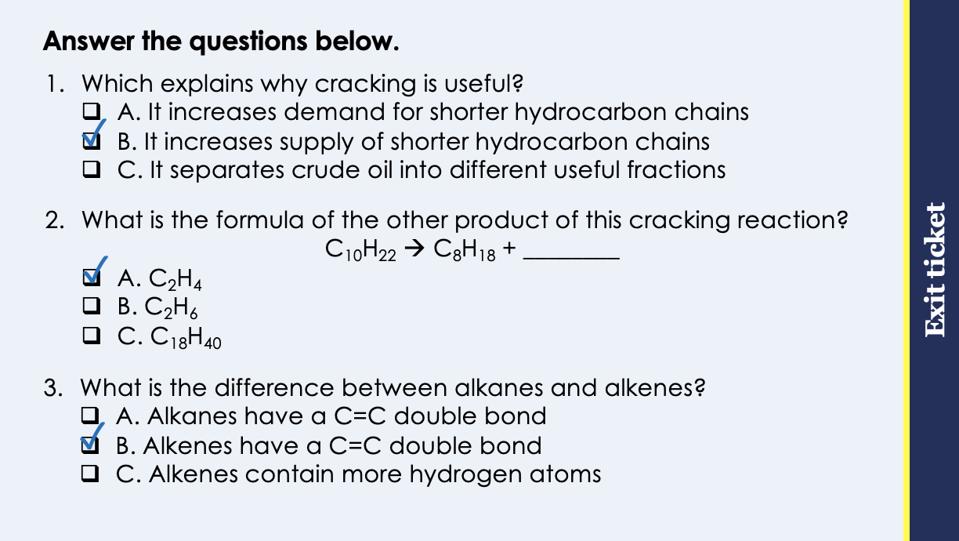
This is the fix-it portion of the lesson
The fix-it is an opportunity to respond to gaps in knowledge, especially those identified by the pre-unit quiz.
The teacher should customise this slide as needed, to facilitate
reteach, explanation, demonstration or modelling of ideas and concepts that students have not yet grasped or have misunderstood.
practise answering specific questions or of key skills.
redrafting or improving previous work.
Notes:
Purpose: to spend time on any gaps identified in previous learning from previous exit ticket.
Guidance from previous exit ticket:
Q1. Answer: B
If students answer A, they have confused supply and demand. If students answer C, they have confused the function of fractional distillation and cracking. To fix it, review what happens in both fractional distillation and cracking and show students how they are linked.
Q2. Answer: A
If students answer B, they have correctly calculated the number of carbons in the alkene but not the hydrogens, possibly trying to use the general formula for alkanes. If students answer C, they have added the numbers rather than subtracting. To fix it, give students further practice identifying the formulae of products of cracking.
Q3. Answer: B
If students answer A or C, they have confused alkanes and alkenes. To fix it, review the general formulae for alkanes and alkenes.

Slide 8
Alkenes
The alkenes are a homologous series that contain a Carbon=Carbon double bond.
Ethene
Propene
Butene
C₂H₄
C₃H₆
C₄H₈
H
H
H
H
H
H
H
H
H
C
C
C
C
C
H
C
C
C
C
H
H
H
H
H
H
H
H
The general formula for the alkenes is C_{n}H_{2n}.
The alkenes are unsaturated.
Notes:
Suggested exposition:
In the last lesson, we looked at how cracking is used to break larger alkane hydrocarbon chains into smaller ones. Cracking also produces alkenes, which are useful compounds themselves. Alkenes are a homologous series, a group of compounds with the same functional group, which is a carbon-carbon double bond.
Because of this double bond, the carbon atoms that have formed the double bond cannot bond with another hydrogen atom, so the alkenes contain fewer hydrogen atoms than the alkanes.
Let’s look at the first four alkenes. We can check that the structural formula is correct by counting the number of bonds each atom can make. Hydrogen needs to share one pair of electrons to get a full outer shell, so hydrogen can only ever form a single bond. Carbon has four electrons in its outer shell so needs to share four pairs of electrons to achieve a full outer shell, meaning that all carbon atoms need to make four bonds.
Show students how to count the number of bonds for each carbon atom.
Why would there be no methene?
Because to be an alkene there needs to be a C=C double bond and the prefix meth- means that there is only one carbon atom.
Using this information and the information from last lesson, what is the general formula for the alkenes?
C_{n}H_{2n}
The general formula for the alkenes is C_{n}H_{2n}.
Because of this double bond, the alkenes are unsaturated.
How can we test for saturation?
Adding bromine water. Alkenes would turn bromine water from orange to colourless.
How many hydrogen atoms would there be in pentene, which contains 5 carbon atoms?
10.
How many hydrogen atoms would there be in decene, which contains 10 carbon atoms?
10.
How many carbon atoms would there be in dodecene, which contains 24 hydrogen atoms?
12.

Slide 9
What would the structural formula for pentene be?
H
H
H
H
H
C
C
C
C
C
H
H
H
H
H

Slide 10

Think outside the box!
Why is there no such thing as methene?
Notes:
The functional groups of the alkenes is the C=C double bond, so there need to be at least 2 carbon atoms. The prefix ‘meth’ means one carbon atom.
Suggested guidance:
Talk tasks can be used in a variety of ways to suit the particular needs of the students you are teaching. Through exchanging views with others, students develop their understanding of the science beyond what could be achieved individually.
Science classrooms that successfully integrate talk have the following features:
Science talk is a regular feature of lessons and is woven into classroom activities.
Students are paired or grouped strategically by the teacher to ensure productive interaction. This might take into consideration the students’ proficiency of the English language, how encouraging they might be to peers and their attainment in the topic. It’s a good idea to consider these pairings in the class seating plan.
Students are encouraged and supported to talk, but are not forced to talk.
The teacher should take on the role of a facilitator, engaging with conversations where necessary and encouraging or steering the conversation where needed.
Students are encouraged to use the language they have to express their ideas (e.g., everyday language, imperfect English, native language), but also to incorporate science specific terminology where this is more accurate or has been taught.
6. Scientifically inaccurate ideas are not dismissed by the partner or teacher; open discussion and further investigation are relied on to help students construct ideas that support them to progress in their scientific understanding.
7. Guidelines for behaviour during talk tasks are explicit and frequently reviewed. Rules for students might be:
Listen carefully to your partner
Take turns talking.
Speak one at a time, without interrupting.
Politely agree or disagree and explain why.
Politely point out if your partner has used a scientific word incorrectly, if they have explained the science incorrectly, or if there is a more accurate way to describe something.
If confused, ask questions.
Stay focused on the discussion topic.
Respond to one another.

Slide 11
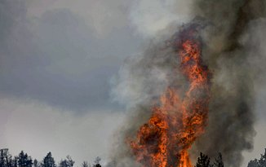
Reactions of Alkenes
Like the alkanes, the alkenes show patterns in physical properties, such as boiling points.
The alkenes have similar chemical properties because of their C=C double bonds, which makes them reactive.
Alkenes react with oxygen in combustion reactions in the same way as other hydrocarbons, but they tend to burn in air with smoky flames because of incomplete combustion.
Notes:
Suggested exposition:
The alkenes have similar chemical properties because of their C=C double bonds.
Like the alkanes, they also show variation and a pattern in their physical properties, such as boiling point.
What might the pattern with boiling point and size of alkenes be?
The larger the alkenes, the higher the boiling point.
Why?
Because as the molecule gets bigger, the intermolecular forces increase. Alkenes react with oxygen in combustion reactions in the same way as other hydrocarbons, but they tend to burn in air with smoky flames because of incomplete combustion.
When does incomplete combustion happen?
When there is a limited supply of oxygen/air.
Image from pixabay

Slide 12
Reactions of Alkenes
The functional group (C=C) of the alkenes allows them to undergo addition reactions.
Ethene
Bromine
1,2-dibromoethane
H
H
H
H
C
C
+
Br
Br
→
H
C
C
H
H
H
Br
Br
Alkenes react with other halogens in the same way:
Alkene + halogen → halogenalkane
Ethene + chlorine → (1,2-)dichloroethane
Ethene + iodine → (1,2-)diiodethane
Notes:
Suggested exposition:
The functional group, C=C, of the alkenes allows them to undergo addition reactions.
In an addition reaction, atoms are added across the double bond so that the double bond becomes two separate single bonds with the new atoms. This is the reaction that takes place when bromine water is added to an alkene.
For example, ethene reacts with bromine to form 1,2-dibromoethane. Animate reaction.
The name 1,2-dibromoethane sounds much more complicated than it really is.
The 1 and 2 are there to show which carbon atoms the new atoms have bonded to. This is not necessary for ethene since there are only two carbon atoms but we will use the convention to get used to it. ‘Di’ just means two non-metal atoms, like carbon dioxide contains two oxygen atoms. Ethane is then at the end because the compound now only has single bonds so has become an alkane rather than an alkene.
This is why the bromine water is discoloured - a new product has been formed.
Bromine is a halogen and alkenes react in the same way with other halogens, as they are all diatomic. These reactions are normally spontaneous, meaning they do not require heat or a catalyst.
The addition reaction would occur in the same way, just with the other halogen atoms taking the place of the bromine atoms.
For example, ethene + chlorine would produce dichloroethane and ethene + iodine would produce diiodethane.

Slide 13
Reactions of Alkenes
Alkenes can also react with hydrogen in a specific addition reaction called hydrogenation.
These reactions are not spontaneous and require a catalyst.
Ethene
Hydrogen
Ethane
H
H
H
H
C
C
+
H
H
→
H
C
C
H
H
H
H
H
Notes:
Suggested exposition:
Alkenes can also react with hydrogen in a specific addition reaction called hydrogenation, where hydrogen is added.
These reactions are not spontaneous and require a catalyst.

Slide 14




Which statements do you agree with?
Alkenes are unsaturated because they contain a double bond
Alkenes are saturated because they contain a double bond
The double bond is between two carbon atoms
The double bond is between a carbon atom and a hydrogen atom
Notes:
Suggested points:
This talk task is designed to ensure that students are clear on the properties of the different fractions, drawing out if they understand the difference between high and low volatility and viscosity.
Blue: incorrect
Yellow: correct
Green: correct
Pink: incorrect
Suggested guidance:
Talk tasks can be used in a variety of ways to suit the particular needs of the students you are teaching. Through exchanging views with others, students develop their understanding of the science beyond what could be achieved individually.
Science classrooms that successfully integrate talk have the following features:
Science talk is a regular feature of lessons and is woven into classroom activities.
Students are paired or grouped strategically by the teacher to ensure productive interaction. This might take into consideration the students’ proficiency of the English language, how encouraging they might be to peers and their attainment in the topic. It’s a good idea to consider these pairings in the class seating plan.
Students are encouraged and supported to talk, but are not forced to talk.
The teacher should take on the role of a facilitator, engaging with conversations where necessary and encouraging or steering the conversation where needed.
Students are encouraged to use the language they have to express their ideas (e.g., everyday language, imperfect English, native language), but also to incorporate science specific terminology where this is more accurate or has been taught.
6. Scientifically inaccurate ideas are not dismissed by the partner or teacher; open discussion and further investigation are relied on to help students construct ideas that support them to progress in their scientific understanding.
7. Guidelines for behaviour during talk tasks are explicit and frequently reviewed. Rules for students might be:
Listen carefully to your partner
Take turns talking.
Speak one at a time, without interrupting.
Politely agree or disagree and explain why.
Politely point out if your partner has used a scientific word incorrectly, if they have explained the science incorrectly, or if there is a more accurate way to describe something.
If confused, ask questions.
Stay focused on the discussion topic.
Respond to one another.

Slide 15

Can you explain the difference between these two types of compound?
What is the general formula of each?
Which is saturated?
How could you tell the difference between them?
Which is more reactive?
What are examples of each?
Alkane
Alkene
Notes:
Suggested guidance:
Talk tasks can be used in a variety of ways to suit the particular needs of the students you are teaching. Through exchanging views with others, students develop their understanding of the science beyond what could be achieved individually.
Science classrooms that successfully integrate talk have the following features:
Science talk is a regular feature of lessons and is woven into classroom activities.
Students are paired or grouped strategically by the teacher to ensure productive interaction. This might take into consideration the students’ proficiency of the English language, how encouraging they might be to peers and their attainment in the topic. It’s a good idea to consider these pairings in the class seating plan.
Students are encouraged and supported to talk, but are not forced to talk.
The teacher should take on the role of a facilitator, engaging with conversations where necessary and encouraging or steering the conversation where needed.
Students are encouraged to use the language they have to express their ideas (e.g., everyday language, imperfect English, native language), but also to incorporate science specific terminology where this is more accurate or has been taught.
6. Scientifically inaccurate ideas are not dismissed by the partner or teacher; open discussion and further investigation are relied on to help students construct ideas that support them to progress in their scientific understanding.
7. Guidelines for behaviour during talk tasks are explicit and frequently reviewed. Rules for students might be:
Listen carefully to your partner
Take turns talking.
Speak one at a time, without interrupting.
Politely agree or disagree and explain why.
Politely point out if your partner has used a scientific word incorrectly, if they have explained the science incorrectly, or if there is a more accurate way to describe something.
If confused, ask questions.
Stay focused on the discussion topic.
Respond to one another.

Slide 16
Drill
State the general formula for alkenes.
State the chemical formula for ethene.
State the chemical formula for butene.
Identify the functional group of the alkenes.
Explain whether the alkenes are saturated or unsaturated.
Describe how to test for the presence of an alkene.
Predict the product formed when propene reacts with hydrogen.
Predict the product formed when ethene reacts with bromine.
Notes:
Purpose: This is a knowledge drill. The purpose of this is to check that the critical knowledge is secure before pupils move onto independent practice.
Suggested guidance: There are a range of ways this could be done depending on time and ability range of the class:
Mini whiteboards
As full sentences in exercise books
As short answers in exercise books
In the pupil workbook
As pair talk
As cold call

Slide 17
Drill answers
C_{n}H_{2n}
C₂H₄
C₄H₈
C=C
Unsaturated because they contain the C=C double bond
Add bromine water. If an alkene is present, bromine water will turn from orange to colourless.
Propane
(1,2) dibromoethane
Notes:
Purpose: This is a knowledge drill. The purpose of this is to check that the critical knowledge is secure before pupils move onto independent practice.
Suggested guidance: There are a range of ways this could be done depending on time and ability range of the class:
Mini whiteboards
As full sentences in exercise books
As short answers in exercise books
In the pupil workbook
As pair talk
As cold call

Slide 18
I: Alkene reactions
Ethene can react with bromine or with hydrogen in the presence of a catalyst.
Predict the product of the reaction between ethene and hydrogen.
Ethene
Hydrogen
Ethane
H
H
H
H
C
C
+
H
H
→
H
C
C
H
H
H
H
H
Predict the product of the reaction between ethene and bromine.
Ethene
Bromine
1,2-dibromoethane
H
H
H
H
C
C
+
Br
Br
→
H
C
C
H
H
H
Br
Br
Notes:
Purpose: The I-We-You section aims to support pupils to build skills that they most commonly need when answering questions associated with this knowledge in the assessment. This section is also used to interleave other content we expect pupils to know at this stage of their education in order that they build a big picture of the science they are learning.
For the ‘I’ activity, the teacher should model how to answer the question. They can do this by narrating their thinking process aloud, and making links to learning earlier in the lesson explicit.
For the ‘we’ activity, the teacher and students work though a similar example together, in order to prepare students to be able to answer a similar question independently.
Opportunities for the ‘you’ activity – independent practise – occur in the activity portion of the lesson once the student is secure enough to process independently.

Slide 19
We: Alkene reactions
Propene can react with bromine or with hydrogen in the presence of a catalyst.
Predict the product of the reaction between propene and hydrogen.
Propene
Hydrogen
Propane
H
H
H
H
H
H
C
C
C
H
+
H
H
→
H
C
C
C
H
H
H
H
H
H
Predict the product of the reaction between propene and bromine.
Propene
Bromine
1,2-dibromopropane
H
H
H
H
H
H
C
C
C
H
+
Br
Br
→
H
C
C
C
H
H
H
Br
Br
H
Notes:
Purpose: The I-We-You section aims to support pupils to build skills that they most commonly need when answering questions associated with this knowledge in the assessment. This section is also used to interleave other content we expect pupils to know at this stage of their education in order that they build a big picture of the science they are learning.
For the ‘I’ activity, the teacher should model how to answer the question. They can do this by narrating their thinking process aloud, and making links to learning earlier in the lesson explicit.
For the ‘we’ activity, the teacher and students work though a similar example together, in order to prepare students to be able to answer a similar question independently.
Opportunities for the ‘you’ activity – independent practise – occur in the activity portion of the lesson once the student is secure enough to process independently.

Slide 20
You: Alkene reactions
Butene can react with bromine or with hydrogen in the presence of a catalyst.
Predict the product of the reaction between butene and hydrogen.
Butene
Hydrogen
Butane
H
H
H
H
H
H
H
H
C
C
C
C
H
+
H
H
→
H
C
C
C
C
H
H
H
H
H
H
H
H
Predict the product of the reaction between butene and bromine.
Butene
Bromine
1,2-dibromobutane
H
H
H
H
H
H
H
H
C
C
C
C
H
+
Br
Br
→
H
C
C
C
C
H
H
H
H
Br
Br
H
H
Notes:
Purpose: The I-We-You section aims to support pupils to build skills that they most commonly need when answering questions associated with this knowledge in the assessment. This section is also used to interleave other content we expect pupils to know at this stage of their education in order that they build a big picture of the science they are learning.
For the ‘I’ activity, the teacher should model how to answer the question. They can do this by narrating their thinking process aloud, and making links to learning earlier in the lesson explicit.
For the ‘we’ activity, the teacher and students work though a similar example together, in order to prepare students to be able to answer a similar question independently.
Opportunities for the ‘you’ activity – independent practise – occur in the activity portion of the lesson once the student is secure enough to process independently.

Slide 21
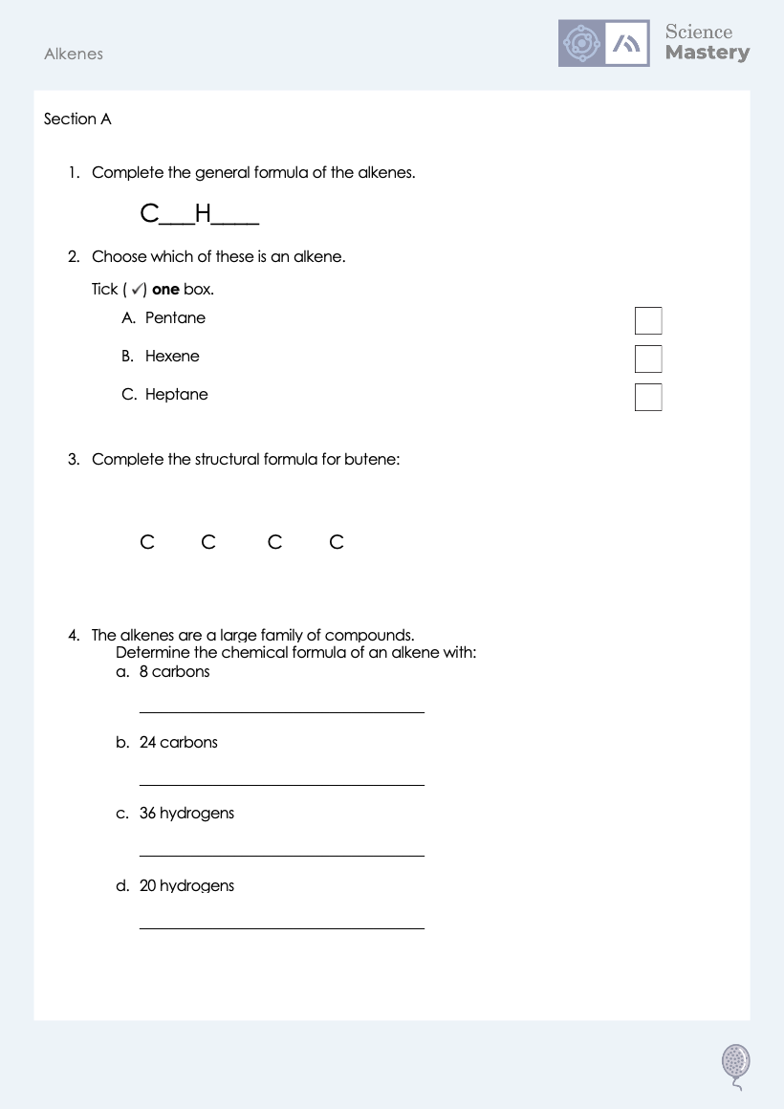
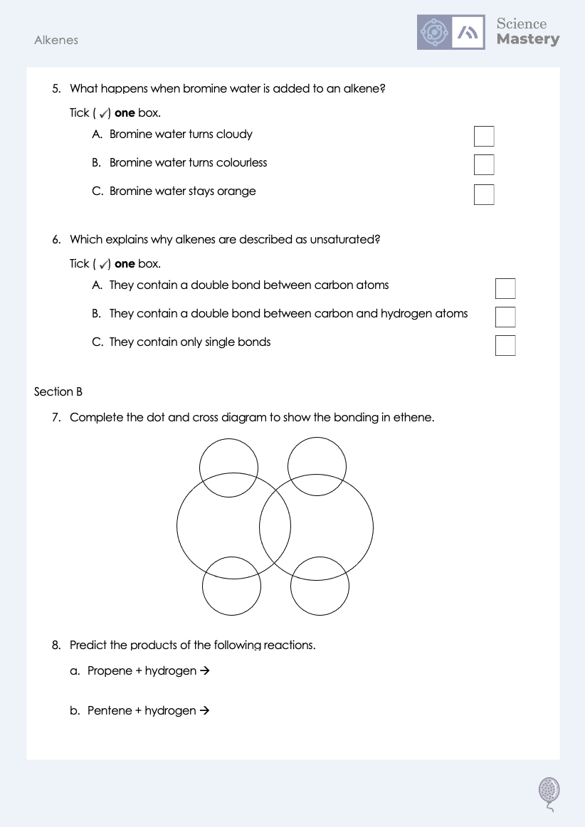
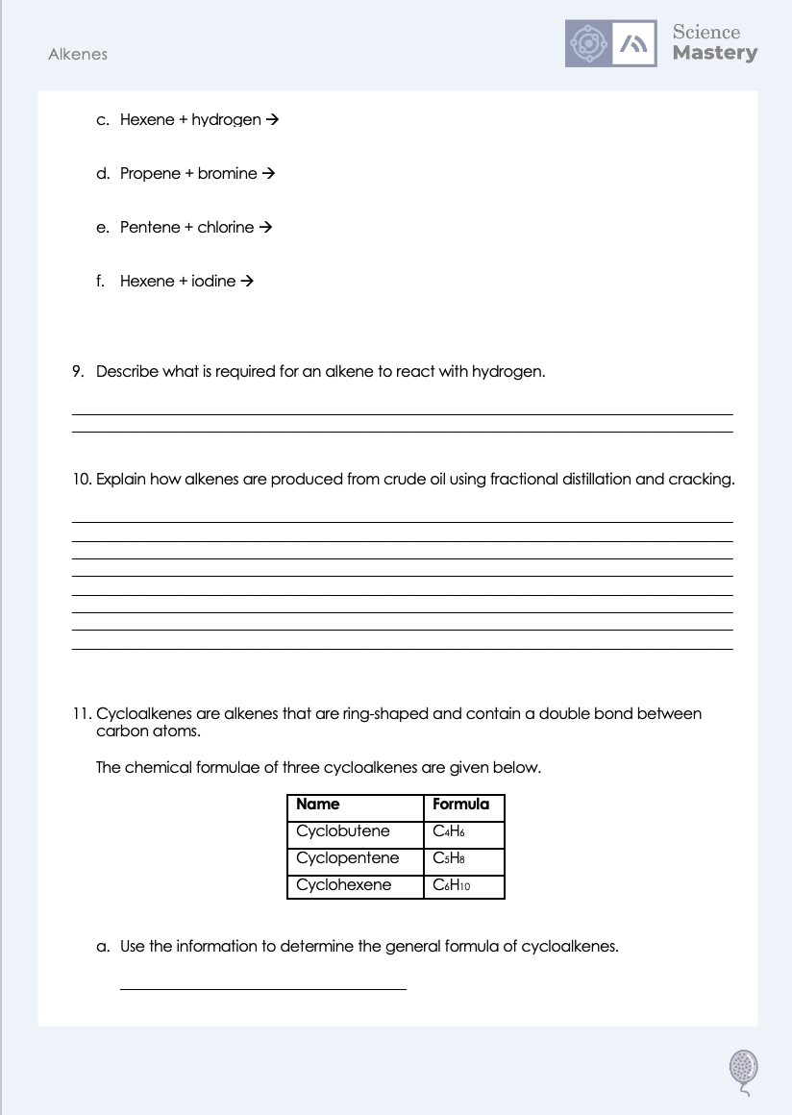
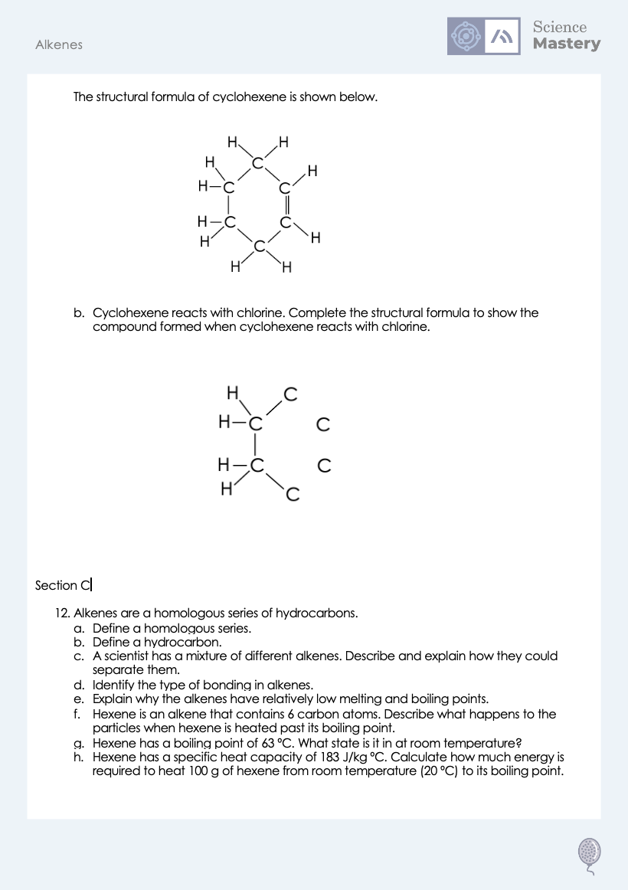
Worksheet

Slide 22
Answers
1. C_{n}H_{2n}
5. B - Bromine water turns colourless
2. B - Hexene
6. A - They contain a double bond between carbon atoms
3.
H
H
H
H
C
C
C
C
H
H
H
H
4a. C₈H₁₆
4b. C₂₄H₄₈
4c. C₁₈H₃₆
4d. C₁₀H₂₀

Slide 23
Answers
7.
8a. Propane
8b. Pentane
X
X
8c. Hexane
X
X
8d. Dibromopropane
8e. Dichloropropane
X
X
8f. Diiodohexane
9. A catalyst is required.

Slide 24
Answers
10. Suggested points:
During fractional distillation, crude oil is heated
In a fractionating column
The column is hotter at the bottom and cooler at the top
The fractions have different boiling points
The fractions condense at different temperatures
Heavy fractions condense at the bottom, smaller fractions condense higher up
Cracking is then used to break the larger hydrocarbons into smaller hydrocarbons
It breaks alkanes into smaller alkanes and alkenes
Cracking requires a catalyst/steam/high temperature

Slide 25
Answers
11a. C_{n}H_{2n-2}
11b.
H
H
H
C
H
H
C
C
Cl
H
C
C
Cl
H
C
H
H
H

Slide 26
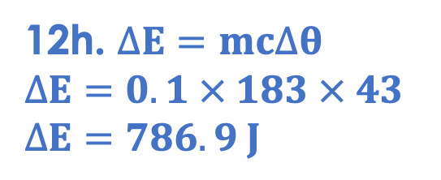
Answers
12a. A group of compounds with the same functional group.
12b. A molecule that contains carbon and hydrogen atoms only.
12c. The boiling points vary with molecule size so distillation could be used to separate the alkenes as they would evaporate then condense at different temperatures.
12d. Covalent bonding
12e. They are covalent molecules so there are weak intermolecular forces between them which require little energy to overcome.
12f. The hexene molecules overcome the forces holding them together and spread apart, moving at random speeds in random directions.
12g. Liquid
12h. $∆E=mc∆θ$
$$∆E=0.1 × 183 × 43$$
$$∆E=786.9 J$$

Slide 27
Answer the questions below.
What is the general formula for the alkenes?
A. C_{n}H_{2n}
B. C_{n}H_{2n+2}
C. C_{n}H_{n}
✓
Which explains why alkenes are reactive?
A. They are saturated
B. They are unsaturated
C. They are small molecules
✓
What product would be formed when propene reacts with hydrogen?
A. Butene
B. Propane
C. Hydropropene
✓
Notes:
Q1. Answer: A
If students answer B, they have confused the general formulae for alkanes and alkenes. If students answer C, they have made the common mistake of noticing that there is no +2 but have forgotten that the number of hydrogens is still 2x the number of carbons. To fix it, review the general formula for the alkenes.
Q2. Answer: B
If students answer A, they are not clear on the difference between a saturated and an unsaturated molecule. If students answer C, they have confused the physical and chemical properties. To fix it, review what happens when alkenes react with hydrogen or bromine.
Q3. Answer: B
If students answer A, they may have the misconception that the name of the compound comes from the number of hydrogens rather than carbons. If students answer C, they have confused hydrogenation with naming convention from a bromine addition reaction. To fix it, review the different products that can be made though the alkene reactions.

Slide 28
Lesson C5.1.6
What was good about this lesson? | What can we do to improve this lesson?
Send us your feedback by clicking this link
or by emailing sciencemastery@arkonline.org
Thank you!

